Slide 1
DNA ELECTROPHORESIS
Name:
Course:
Instructor:
Date:

Slide 2
Introduction
Got its name from electromotive force.
Charged particles move under the influence of electric field from one electrode to the other.
If they are passed through a medium they can be separated on the basis of their sizes.
DNA is negatively charged, its fragments moves towards anode (Westermeier, 2016).

Slide 3
Uses Of Dna Electrophoresis
• To separate DNA fragments from each other
• To determine the sizes of DNA fragments
• To determine the presence or amount of DNA
• To analyze restriction digestion products

Slide 4
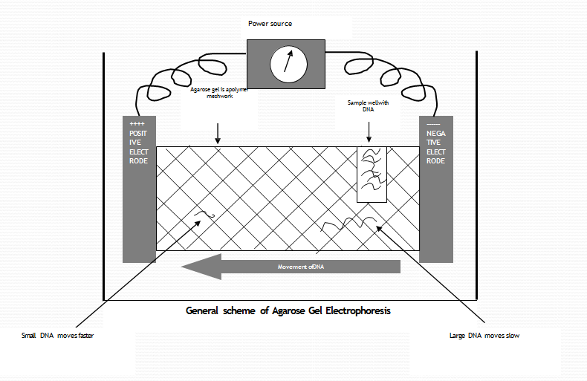
Process Illustration

Slide 5
Requirements of the Process
  Materials required for gel electrophoresis includes:
  Electrophoresis chamber
  Gel
  Gel casting tray
  Buffer
  Staining agent (dye)
  A comb
  DNA ladder
  Sample to be separated

Slide 6
Gel Types Used During DNA Electrophoresis
  Depending on the size of fragments different materials can be used for electrophoresis.
  Agarose: Chains of branched and unbranched carbohydrates. Mostly used for larger DNA fragments. Contains no cross links.
  Polyacrylamide: Amides of acrylic acid. Used for resolving smaller fragments. It forms cross links with bisacrylamide (Westermeier, 2016).

Slide 7
Agarose Gel Electrophoresis
Agarose is a linear carbohydrate polymer extracted from seaweed , agarobiose that forms a porous matrix.
As Agarose gels and shifts from random coil in solution to structure in which chains are bundled into double helices
Agarose in solid form is mixed with buffer and heated for sometime.
Fix the combs according to required wells in the casting apparatus.
Poured in gel casters and allowed to solidify at room temperature.

Slide 8
Types Of Agarose
1. Standard Agarose
Gels at 35-38oC Melts at 90-95o C
Becomes opaque at high concentrations
2. Low Melting Agarose (NuSieve)
Gels at 35o C; Melts at 65o C
Often used to isolate DNA fragments from gel
3. Intermediate forms or combinations of LE and NuSieve can provide sturdy, translucent gels at high agarose

Slide 9
Polyacrylamide Gel
Acryamide and bisacrylamide are dissolved in buffer.
Ammonium persulfate and TEMED are used to polymerize the gel.
Gel is poured in casters (plates), fixed the combs and allowed to stay for sometime to polymerize.

Slide 10
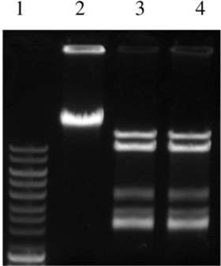
Detection
Ethidium Bromide is added into the gel prior to solidification.
Gel is visualized under UV.
EtBr. Intercalates with DNA and gives fluorescence under UV.
Visualization

Slide 11
Capillary Gel Electrophoresis
Capillary filled with matrix is used instead of large gel tank.
A source vial (anode) and a destination vial (cathode) both filled with a buffer and a sample vial.
Capillary is first dipped in sample vial and then in source vial.
Movement under osmo-electric flow.

Slide 12
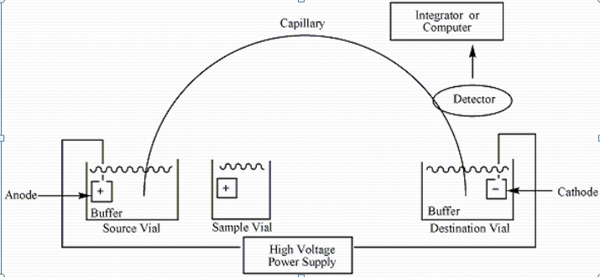
Capillary Gel Electrophoresis Illustration

Slide 13
Pulsed-field Gel Electrophoresis
Specialized to separate larger fragments ranging from 10Kb to 10Mb.
Current is not passed in one direction, instead alternatively at different angles and it is not continuous but in the form of pulses (Kaufmann & Pitt, 2018).

Slide 14
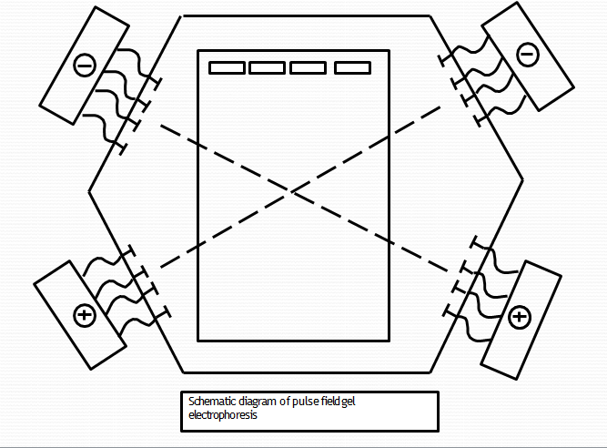
Pulsed-field Gel Electrophoresis ILLUSTRATION

Slide 15
Applications
In laboratory diagnosis of diseases.
During DNA sequencing.
Family applications for paternity and maternity tests.
Organisms identification.
Forensics application to identify suspects (Devi et al, 2015).

Slide 16
References
Devi, S. G., Fathima, A. A., Radha, S., Arunraj, R., Curtis, W. R., & Ramya, M. (2015). A rapid and economical method for efficient DNA extraction from diverse soils suitable for metagenomic applications. PLoS One, 10(7), e0132441.
Kaufmann, M. E., & Pitt, T. L. (2018). Pulsed-field gel electrophoresis of bacterial DNA. In Methods in practical laboratory bacteriology (pp. 83-92). CRC Press.
Westermeier, R. (2016). Electrophoresis in practice: a guide to methods and applications of DNA and protein separations. John Wiley & Sons.

